Slide 1
Innovation Project
Lego League 2024-2025 Session
Theme: Submerged
Team: Rising Stars
Team No : 66782
Notes:
Riya

Slide 2
Team Members
Name Age
Riya Patil 11
Shaivi Aggarwal 10
Saanvi Loomba 10
Riona Panda 9
Zoey Jain 10
Saumya Loomba 10
Notes:
Riya

Slide 3
Current Challenges
The ocean has a lot of problems:
Trash, pollution, excessive drilling .
Rise in sea temperature and Carbon dioxide pollution etc. only 20% of the Ocean surface is mapped
We decided to work on a solution to map remaining 80% of ocean to address ocean issues in the unmapped area of the ocean.
Notes:
Riya
80 percent of the ocean is unmapped.
Variable temperature changes.

Slide 4
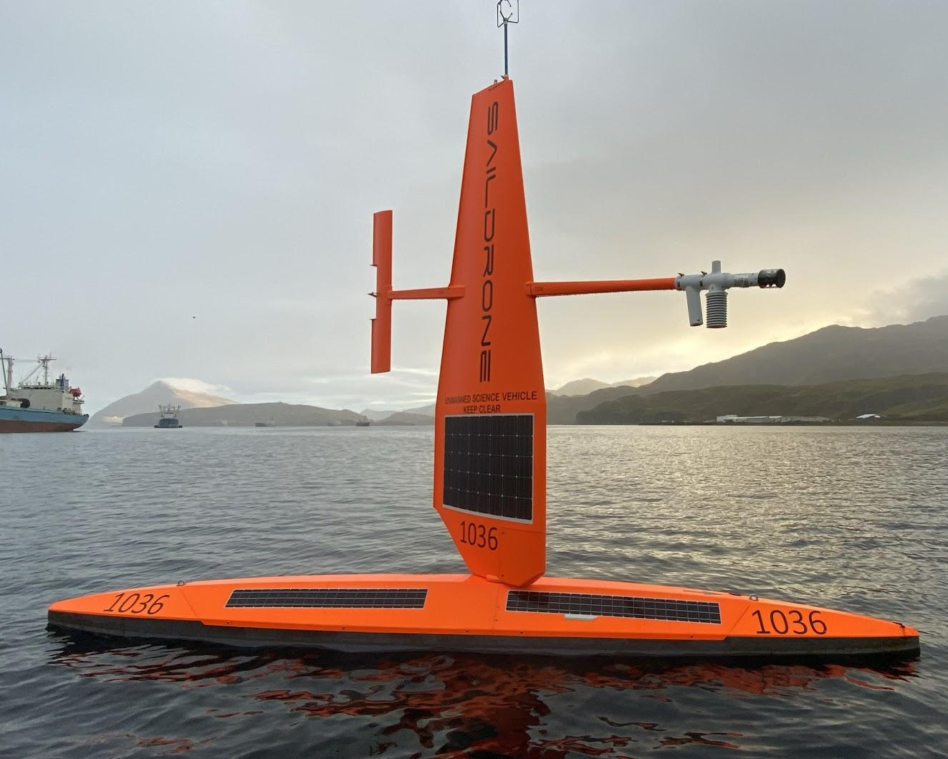
Solution: Mapping the ocean
We created sail boat drones to map the ocean
We use sonar to find the depth of the ocean.
We put solar panels on the drone to capture sun light to create electricity for the drone
Notes:
Riya
We Sonar is to find the depth of the ocean.
Foam is lightweight and it is durable and easy to float.
Red color so it can pop out.
Two buddy drones to share map the ocean.
Solar panel collect solar energy that is less carbon.

Slide 5
Project Plan
Did research and prepared rough drawings
Create a Model for the Saildrone
We created a supply list to cut out different part of the sail drone
We hot glued different parts of the sail drones.
We created two sail drones to divide and conquer the mapping exercise.
We also added specific sensors.
Notes:
Shaivi

Slide 6
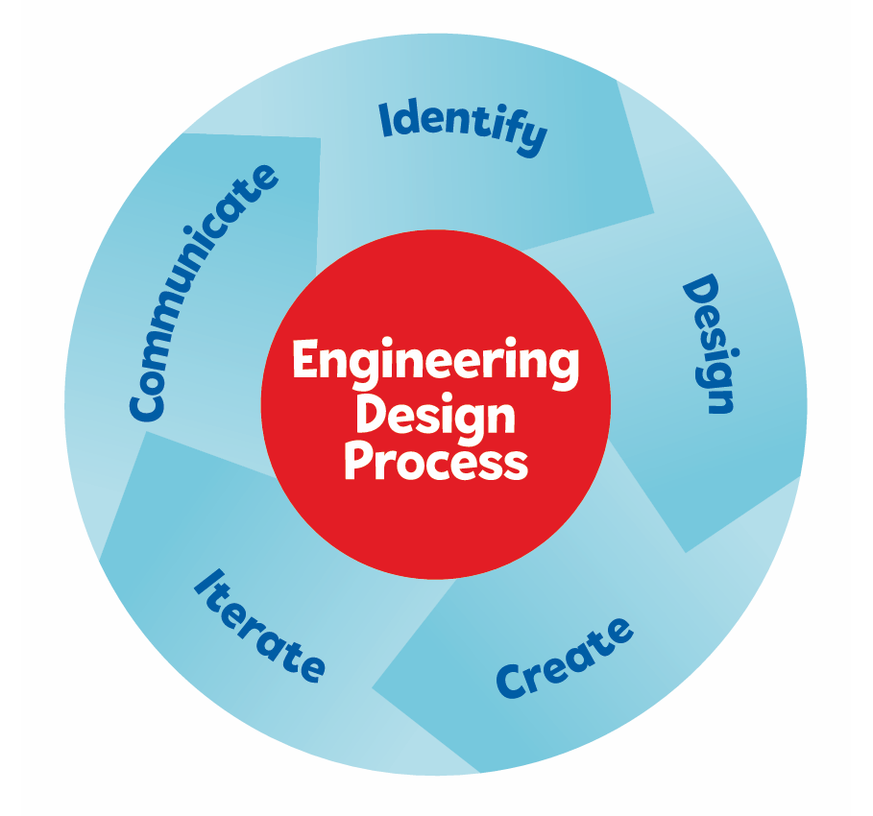
Engineering Design Process
Notes:
Shaivi

Slide 7
Final Ideas Shortlisted for working
Extendable arm to collect trash from the ocean
Autonomous Submarine
Mars Rover in the ocean
Sail boat drone
Notes:
Saanvi
Each team member researched and suggested ideas and we picked following ideas for more analysis. We started with some rover with extendable arm but then saw problems and limitations with that so we picked sail boat drone as this will have maximum impact and will be easy to implement.

Slide 8
Final Idea developed and applied improvements
We chose the saildrone to solve real world problem because the ocean is a mystery.
Large areas of ocean are unexplored and only small part is mapped and sail drones can map the ocean intelligently.
Mapping of unexplored oceans will help us understand ocean issues.
Notes:
Saanvi
Ocean life has a direct impact on our life, so the more we know about the ocean the better.
Large part of Oceans are unexplored and our project can help map those unexplored parts and will help us understand ocean problems better

Slide 9
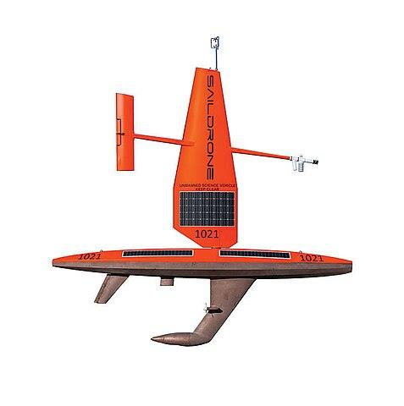
Sailboat drone
Our future depends on understanding the ocean.
Swarm of sail boat drone can operate autonomously year round and collect data.
It has computer that collects and sends real-time data.
It also has sensors for sensing weather, fishes, location Gps,and sonar for ocean depth.
It can come back to the base station automatically for maintenance .
Notes:
riona

Slide 10
Model Developed
We cut a foam sheet and made 17 different pieces
We made the base of the saildrone oval shaped so that it could speed through the water with ease
We made the sail drone a bright red color so that it could be spotted from a distance
The sonar is on the bottom of the sail drone so that it can map the ocean, if the sonar was on the top it would not map anything because the sky is endless
We put the solar panels on the surface of the drone so that it can see and conduct energy from the sun.
Notes:
riona

Slide 11
Iterate and Improve
We started with a drawing on sheet of paper based upon our online research.
We built first model and got some feedback and then created second model
We then built second one with changes,like additional solar panels and stabalizers for balancing
We got additional feedback from surveys and made more improvements after our regional competition.
Notes:
Zoey
We started with a huge sheet of foam.We used knifes to care the pieces the foam into sail drone shape. We also made two sail so that one of them can map the eastern hemisphere, and the other can map the western hemisphere. We improved the second one by learning from our mistakes.

Slide 12
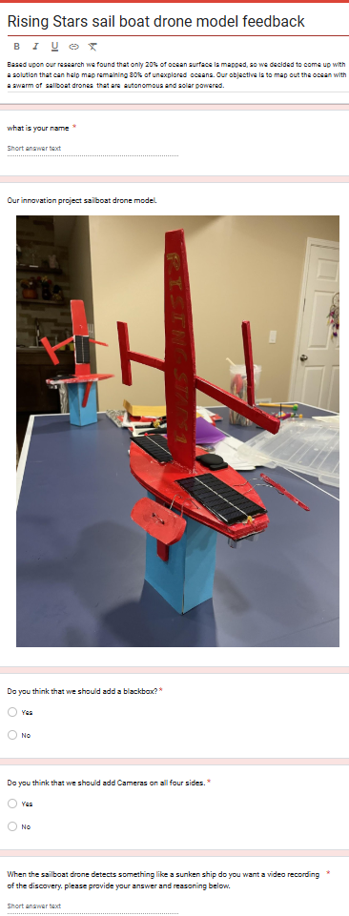
Survey feedback for the project
We made a survey to get feedback and received 30+ responses to
make our model better.
We reached out to the Sail drone company for their expert opinions
Feedback applied
We added a propeller to power the sail drone when there is no wind or sun
We added a battery pack to store excess energy for the propeller
We also added a GPS tracker so that if the drone sails off track we can find it
Notes:
zoey

Slide 13
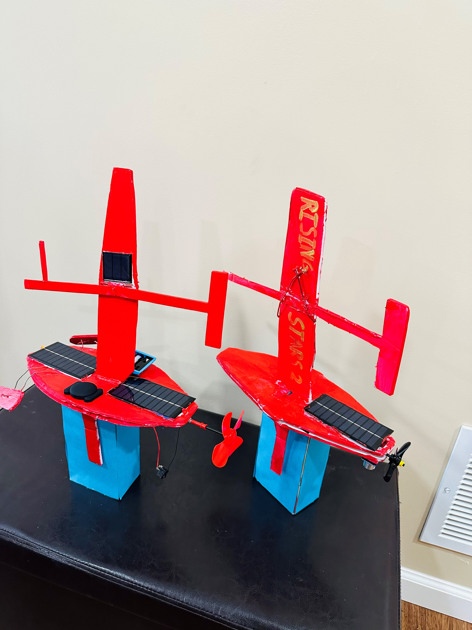
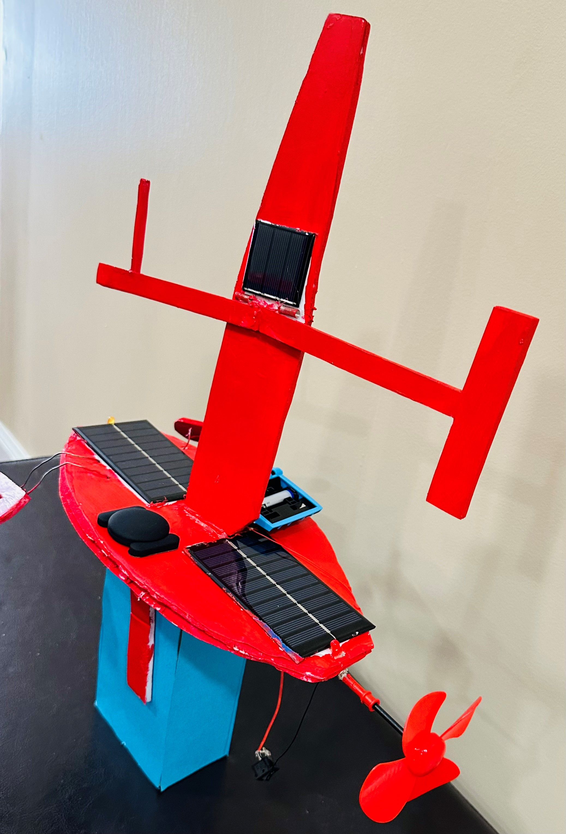
Feedback summary-GPS Tracker
Finding it when it get lost
Phone tracking whenever you want.
Collecting important data of the sailboat drones route.
2
3
1
Notes:
saumya

Slide 14
Real Life impact and Future uses
Sail boat Drones Collect Data.
Sail Drones help with alerting people when Natural Disasters occur.
Sail Drones are environmentally friendly because they have solar panels attached.
Sail Drones can do their job 24/7 because they get their energy from the sun.
Notes:
Saumya

Slide 15
Enjoy the Journey
We worked together as a team.
We solved real world problems and had lot of fun.
We discovered new ways to find a solution when we were struck by sharing ideas.
We had so much fun putting together our model and coloring it together.
We went on a field trip and had so much fun in the USS Cod submarine.
Notes:
Saumya

Slide 16
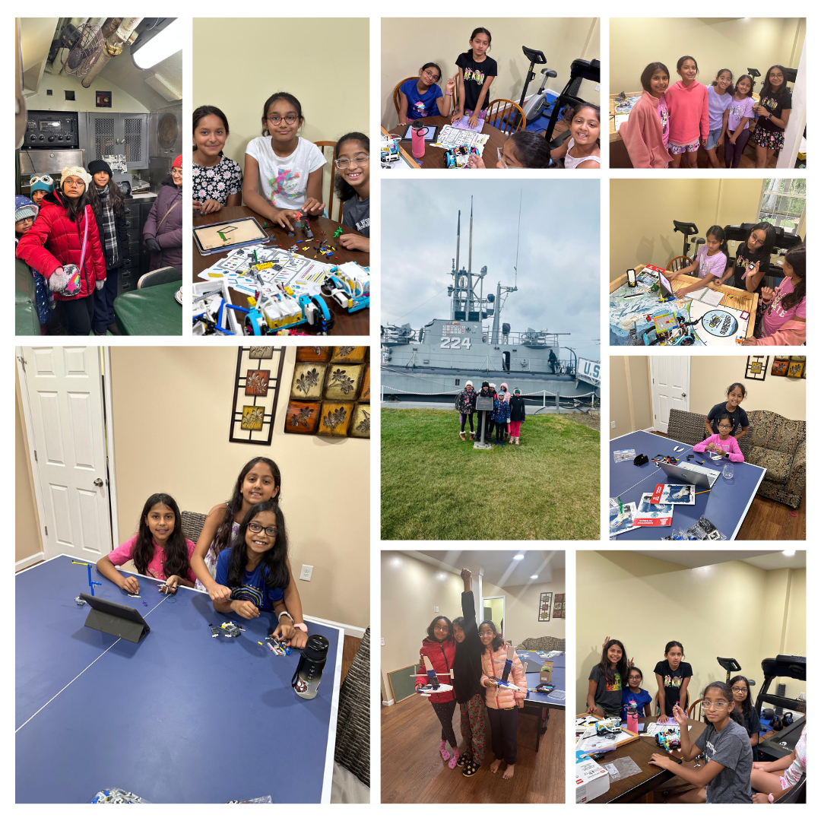
Notes:
Saumya
Here are some pictures we took during our season that captures some of the fun we had working together in team.

